Slide 1

YOU DON'T HAVE
THE TIME
(NOT) TO
TEST
ROB SPECTRE
@dN0t

Slide 2

YOU'VE TAKEN
THE PLUNGE

Slide 3

THIS IS YOUR
CODE YEAR

Slide 4

THIS IS WHEN YOU STOP
BEING EMO

Slide 5

THIS IS WHEN YOU
ROLL UP YOUR SLEEVES

Slide 6

TAKEN ON THE
EAST RIVER

Slide 7

THESE KIDS?
KINDA CREEPY

Slide 8

LEARNING IS
HARD

Slide 9

BASICALLY
AGGRAVATED

Slide 10
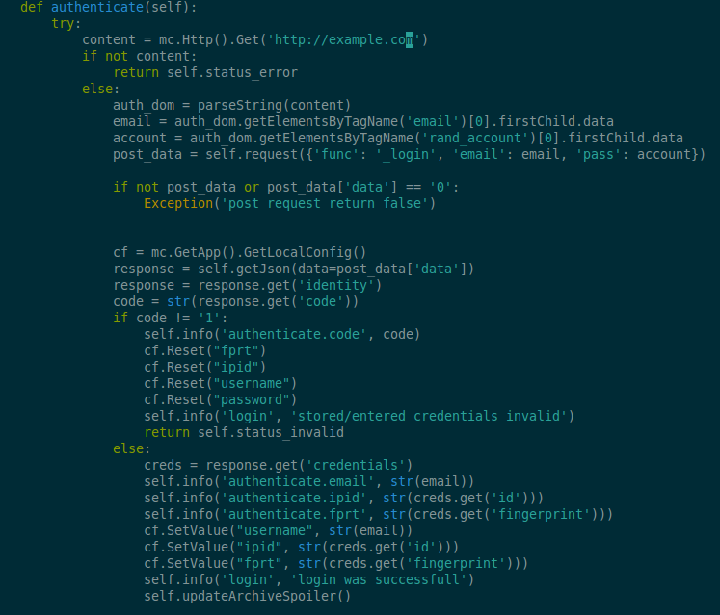
SWEET
JESUS

Slide 11
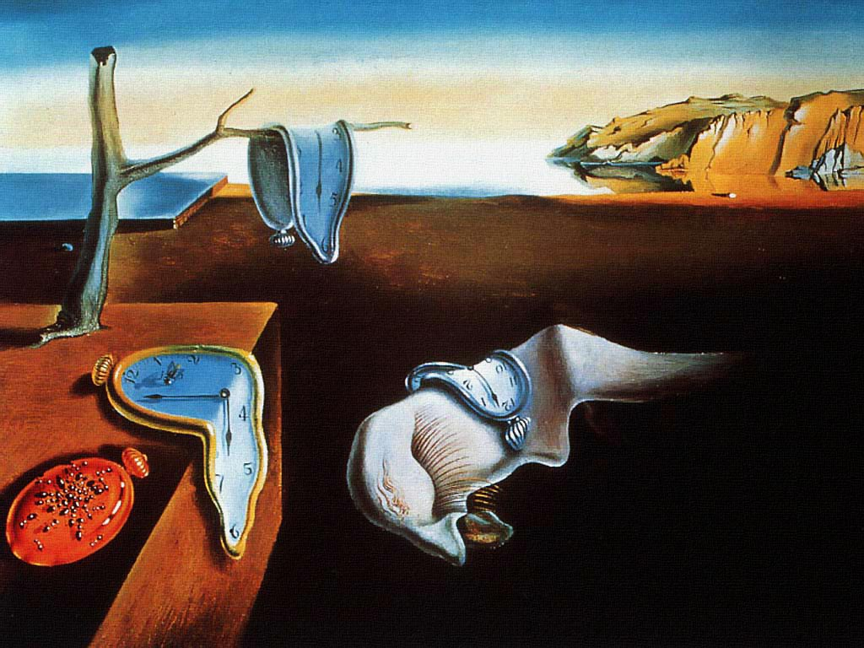
TIME IS FUCKING
MELTING, DUDE

Slide 12

YOU DON'T NEED
JESUS

Slide 13

YOU NEED
ROBOT JESUS

Slide 14

INSIDE
FOXCONN

Slide 15
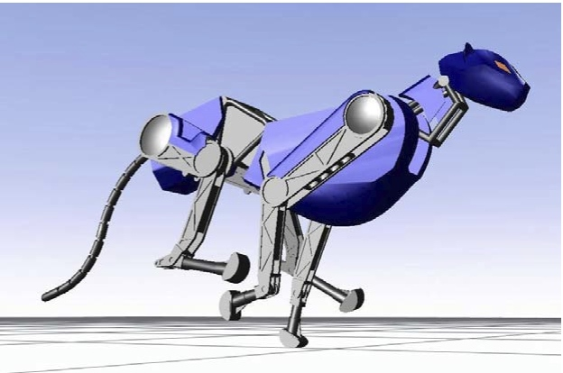
FASTER THAN CHEETAH
IS ROBOT CHEETAH

Slide 16

WE'RE REACHING THE
POINT (BREAK)

Slide 17
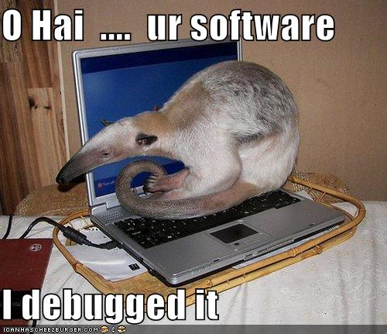
HELLO
WORLD

Slide 18

A WORD OF
WARNING

Slide 19

I MAY BE DUMB
BUT I SURE AM FAT

Slide 20

MY HIGH SCHOOL
GRADUATION

Slide 21

SOME SAY THIS
IS NOT A BUNNY SLOPE

Slide 22

TESTING GOES TO
ELEVEN

Slide 23

THAT IS NOT A
PUDDLE AHEAD

Slide 24

THE FIRST MILE
IS THE HARDEST

Slide 25
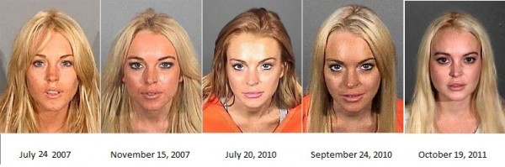
YOU SHOULD AVOID
REPEATING MISTAKES

Slide 26
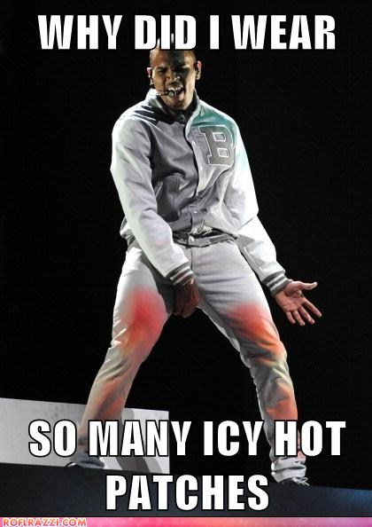
YOU SHOULD NUMB
THE PAIN WITH TESTS

Slide 27
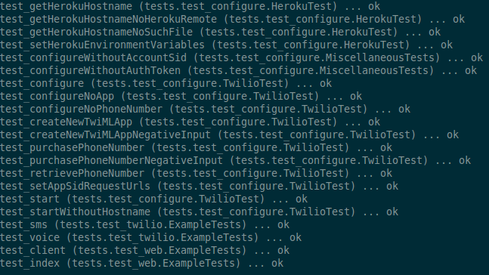
TESTS LOOK A LOT LIKE
CODE

Slide 28
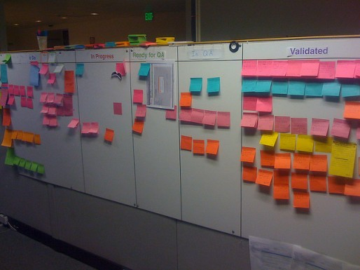
TESTS LOOK A LOT LIKE
USER STORIES

Slide 29

STORIES LOOK A LOT LIKE
PRODUCT SPECS

Slide 30
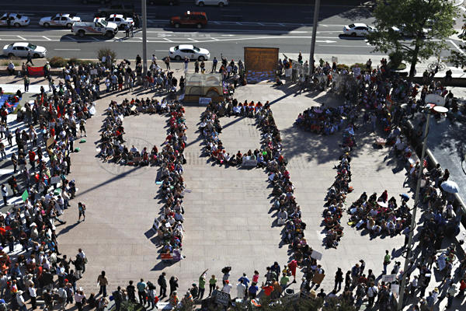
YOU'RE ALREADY THE
1% BY LEARNING CODE

Slide 31
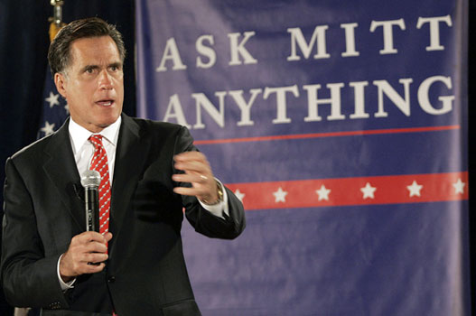
ROMNEY HAS A
REDDIT ACCOUNT, LOL

Slide 32

FUCK IT
WE'LL DO IT LIVE

Slide 33

LET'S GET
REALISTIC

Slide 34

ONLY A SITH THINKS
IN ABSOLUTES

Slide 35

SOYLENT GREEN
IS PEOPLE

Slide 36
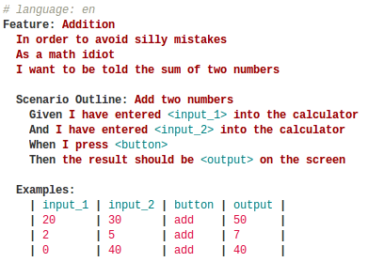
VEGETABLES ARE
TASTY

Slide 37
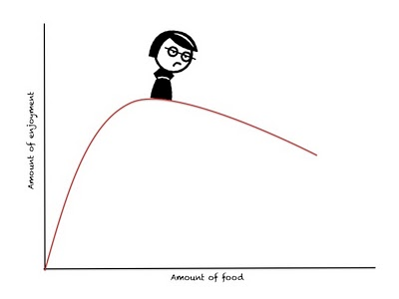
OBSERVE THE
EMO CURVE

Slide 38

TEST YOUR
DATA

Slide 39

GO FOR THE EASY
TREASURE

Slide 40
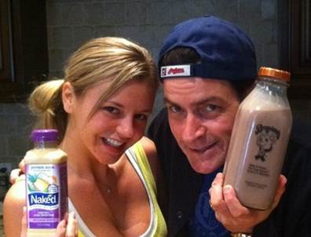
FOCUS ON THE
BEHAVIOR

Slide 41

NO SHAME IN
TRAINING WHEELS

Slide 42

EDDIE ARE YOU
200 OK?

Slide 43

RYAN REYNOLDS LOOKS
BETTER WITH A MASK

Slide 44
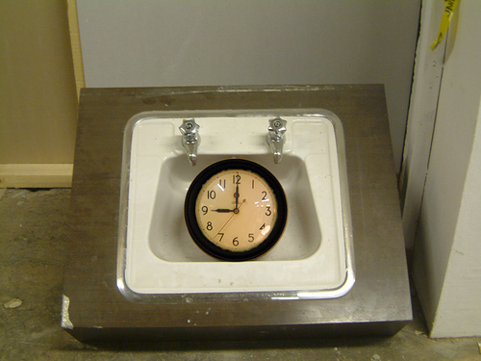
SELENIUM
CAN TAKE A WHILE

Slide 45

ALL THE TESTING BOOKS
FOR NOVICES

Slide 46

REALLY NOT SURE WHAT
THIS COVER IS SAYING

Slide 47
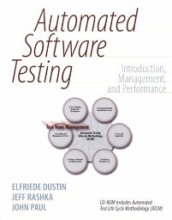
SEXIEST BOOK COVER
EVER

Slide 48

JUST
CHEAT

Slide 49

THAT KID IS ON
THE ESCALATOR AGAIN

Slide 50

UH, WHICH ONE
IS HD?

Slide 51

SERIOUS FRICTION
REDUCTION

Slide 52

ROY LICHTENSTEIN
CONCLUDES A TALK

Slide 53
THANK
YOU!

Slide 54
GITHUB.COM/RobSpectre/Talks
@dN0t
RSPECTRE @TWILIO.COM
BROOKLYNHACKER.COM

